Slide 1
Network Security
CSC 481/681/781
Principles of Computer Security
Reference: Goodrich and Tamassia, Chapter 5

Slide 2
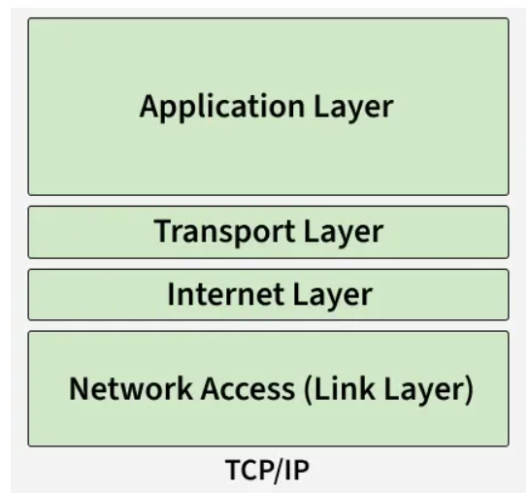
Next: Transport Layer

Slide 3
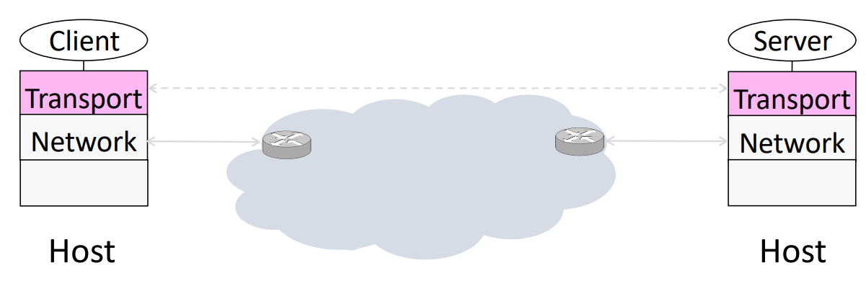
Transport Layer UDP Packets (IP protocol 17)
UDP (User Datagram Protocol) provides end-to-end connectivity to applications
No reliability
No ordering
No congestion control

Slide 4
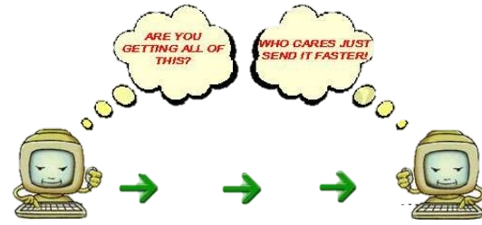
Transport Layer
UDP Packets (IP protocol 17)
UDP is not connection-oriented, So no connection needed to transfer data
Mostly suitable for applications that needs fast and efficient transmission
Used in Video conferencing, Streaming and Voice call

Slide 5
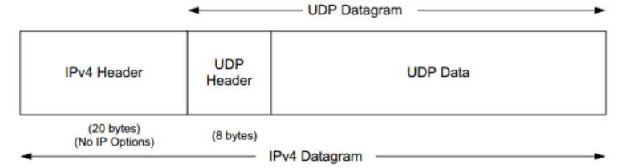
Transport Layer UDP Packets (IP protocol 17)
UDP adds connection distinguishers (ports) to IP:
Some common UDP protocols:
Domain Name Service (DNS) – port 53
Network Time Protocol (NTP) – port 123
“Discoverable” services (IPP, Rendezvous, …)
Streaming/multicast transmissions
0
15
16
31
Source Port
Destination Port
Length
Checksum

Slide 6


Transport Layer Issues
UDP flood DDoS attacks
UDP-DNS
It checks if an application is listening on the destination port;
If not, it replies with an ICMP “destination unreachable” message

Slide 7

Transport Layer Issues
UDP flood DDoS attacks
UDP-random ports, spoofed IP addresses
…
UDP-random ports, spoofed IP addresses
Check packet’s port
Generate ICMP responses
Check…
Generate…
…

Slide 8
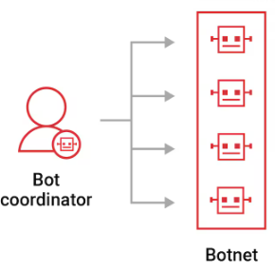
Transport Layer Issues
UDP flood DDoS attacks
What's even worse?
UDP-random ports, spoofed IP addresses
…
UDP-random ports, spoofed IP addresses
…
UDP-random ports, spoofed IP addresses
…
UDP-random ports, spoofed IP addresses

Slide 9
Transport Layer Issues
UDP flood DDoS attacks
UDP-random ports, spoofed IP addresses
…
UDP-random ports, spoofed IP addresses
Legitimate traffic
Unavailable

Slide 10
Transport Layer
TCP Packets (IP protocol 6)
TCP (Transmission Control Protocol) is a connection-oriented protocol, which means a connection is established before transferring data.
Connection should be maintained until the application programs at each end have finished exchanging messages.
TCP is used when data must be delivered correctly and completely.
Reliable data delivery (no loss)
Ordered delivery (no mixing)
Error checking & retransmission
Congestion control

Slide 11
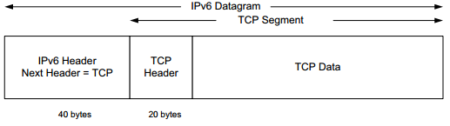
Transport Layer
TCP Packets (IP protocol 6)
TCP adds “sessions” or “connections” to the bare IP protocol:
Some common TCP protocols:
HTTP/HTTPS for web traffic;
SSH for secure management;
FTP for file transfers;
SMTP/IMAP/POP3 for email;
SQL protocols for database management
0
15
16
31
Source Port
Destination Port
Sequence Number
Acknowledgment Number
Data Offset
Flags
Window
Checksum
Urgent Pointer
Options
Data

Slide 12
Creating a TCP Connection
The 3-way handshake
I want to connect
Sends on a SYNchronize segment with a fresh Initial Sequence Number (ISN)
SYN (SEQ=x)

Slide 13
Creating a TCP Connection
The 3-way handshake
I received your request, and I’m ready
Echo on an ACKnowledge segment with a fresh Initial Sequence Number (ISN)
SYN (SEQ=x)
SYN (SEQ=y, ACK=x+1)

Slide 14
Creating a TCP Connection
The 3-way handshake
SYN (SEQ=x)
SYN (SEQ=y, ACK=x+1)
(SEQ=x+1, ACK=y+1)
Connection confirmed
SYNs must be retransmitted if lost

Slide 15
SYN Issues – SYN Flooding
Half-open connection: When the server receives the initial SYN packet, it uses TCB (Transmission Control Block) to store the information about the connection.
Server Data Structures
SYN (SEQ=x)
Half-open conn
S-Seq1
SYN (SEQ=y, ACK=x+1)

Slide 16
SYN Issues – SYN Flooding
Half-open connection: When the server receives the initial SYN packet, it uses TCB (Transmission Control Block) to store the information about the connection.
Server Data Structures
SYN (SEQ=x)
Half-open conn
S-Seq1
SYN (SEQ=y, ACK=x+1)
Half-open conn
S-Seq2
…
…
SYN (SEQ=x)
Half-open conn
S-Seqn
SYN (SEQ=y, ACK=x+1)

Slide 17
SYN Issues – SYN Flooding
Half-open connection: When the server receives the initial SYN packet, it uses TCB (Transmission Control Block) to store the information about the connection.
Server Data Structures
SYN (SEQ=x)
Half-open conn
S-Seq1
SYN (SEQ=y, ACK=x+1)
Half-open conn
S-Seq2
…
…
SYN (SEQ=x)
Half-open conn
S-Seqn
SYN (SEQ=y, ACK=x+1)
DoS isn’t due to traffic volume but to memory exhaustion in the server O.S.

Slide 18
SYN Issues – SYN Flooding
Key points:
Early network stacks had a severely limited number of half-open structures available.
Do not finish the 3rd step of handshake as it will dequeue the TCB record.
When flooding the server with SYN packets, need to use random source IP addresses; otherwise, the attacks may be blocked by the firewalls.
The SYN+ACK packets sent by the server may be dropped because forged IP address may not be assigned to any machine. If it does reach an existing machine, a RST packet will be sent out, and the TCB will be dequeued.
As the above option is less likely to happen, TCB records will mostly stay in the queue. This causes SYN Flooding Attack.

Slide 19

SYN Issues – Countermeasures
SYN cookies: avoid storing state until the handshake is completed
Basic idea: Use cryptography to avoid saving state
Specifically: Store info in Seq # to verify upon ACK
Time: Increments every 64 seconds, prevents reuse of old cookies
MSS = Maximum Segment Size (must be remembered!)
Cryptographic hash w/secret gives unpredictability
Only the server and the receiver of the seq# can reproduce seq#
Not perfect: Limited MSS options, 24-bits can be brute-forced, …
Time t | MSS | Hash(secret, srcIP, destIP, sPort, dPort, t)
5 bits
3 bits
24 bits

Slide 20
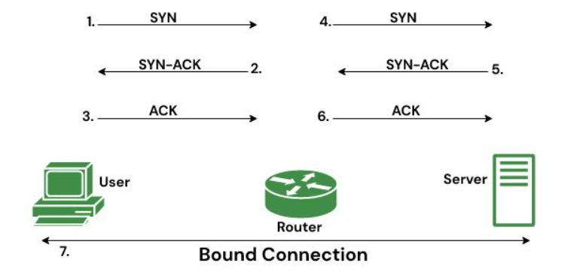
SYN Issues – Countermeasures
TCP Intercept feature: Cisco router “TCP Intercept” feature
The server is not involved
Only verified connections reach the server

Slide 21
SYN Issues – Predictability
What if an attacker can guess sequence number?
SYN (SEQ=x)
SYN (SEQ=y, ACK=x+1)
victim
(SEQ=x+1, Predict ACK+1)
Connected
Particularly dangerous when “fake Src” is a trusted IP address

Slide 22
Combining Techniques The Mitnick Attack
SYN|ACK goes to server,
but ignored because network
has been disabled!
SYN Flood to disable network
victim
SYN (SEQ=x)

Slide 23
Combining Techniques The Mitnick Attack
SYN|ACK goes to server,
but ignored because network
has been disabled!
SYN Flood to disable network
RSTs to re-enable server
Victim’s IP address, SYN (SEQ=x)
victim

Slide 24
Combining Techniques The Mitnick Attack
SYN|ACK goes to server,
but ignored because network
has been disabled!
SYN Flood to disable network
RSTs to re-enable server
Victim’s IP address, SYN (SEQ=x)
SYN (SEQ=y, ACK=x+1)
victim

Slide 25
Combining Techniques The Mitnick Attack
SYN|ACK goes to server,
but ignored because network
has been disabled!
SYN Flood to disable network
RSTs to re-enable server
Victim’s IP address, SYN (SEQ=x)
(SEQ=x+1, Predict ACK+1)
SYN (SEQ=y, ACK=x+1)
Connected
Lessons learned:
In network stack: Seq#’s must be unpredictable!
In network setup: Should filter out local src IPs coming from outside
In application: IP-based trust is a very bad idea!
victim

Slide 26

Higher-level Networking Issues Domain Name System (DNS)
UNCG’s webserver is at 152.13.17.98 - IP works with addresses
People access using “www.uncg.edu”: need to translate names → addresses

Slide 27
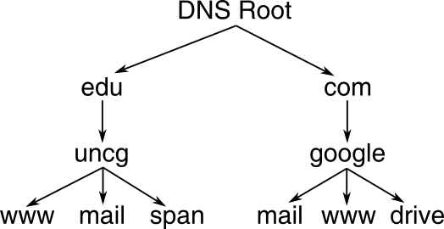
Domain Name System (DNS)
Application layer protocol for name/address management
Domain names: www.example.com
General-to-specific goes right-to-left
.com is a Top-Level Domain (TLD)
Each component (label) is a subdomain of what follows
Naturally forms a tree
TLDs originally simple:
Generic TLDs: .com, .org, .edu, .mil, …
Country TLDs: .us, .uk, .de, .in, ...
Expansion of gTLD space started in 2008
By 2016, over 1000 live TLDs
.info, .biz, .art, .ninja, .games, …
See http://www.iana.org/domains/root/db
Nameserver for each node manages nodes directly below it

Slide 28
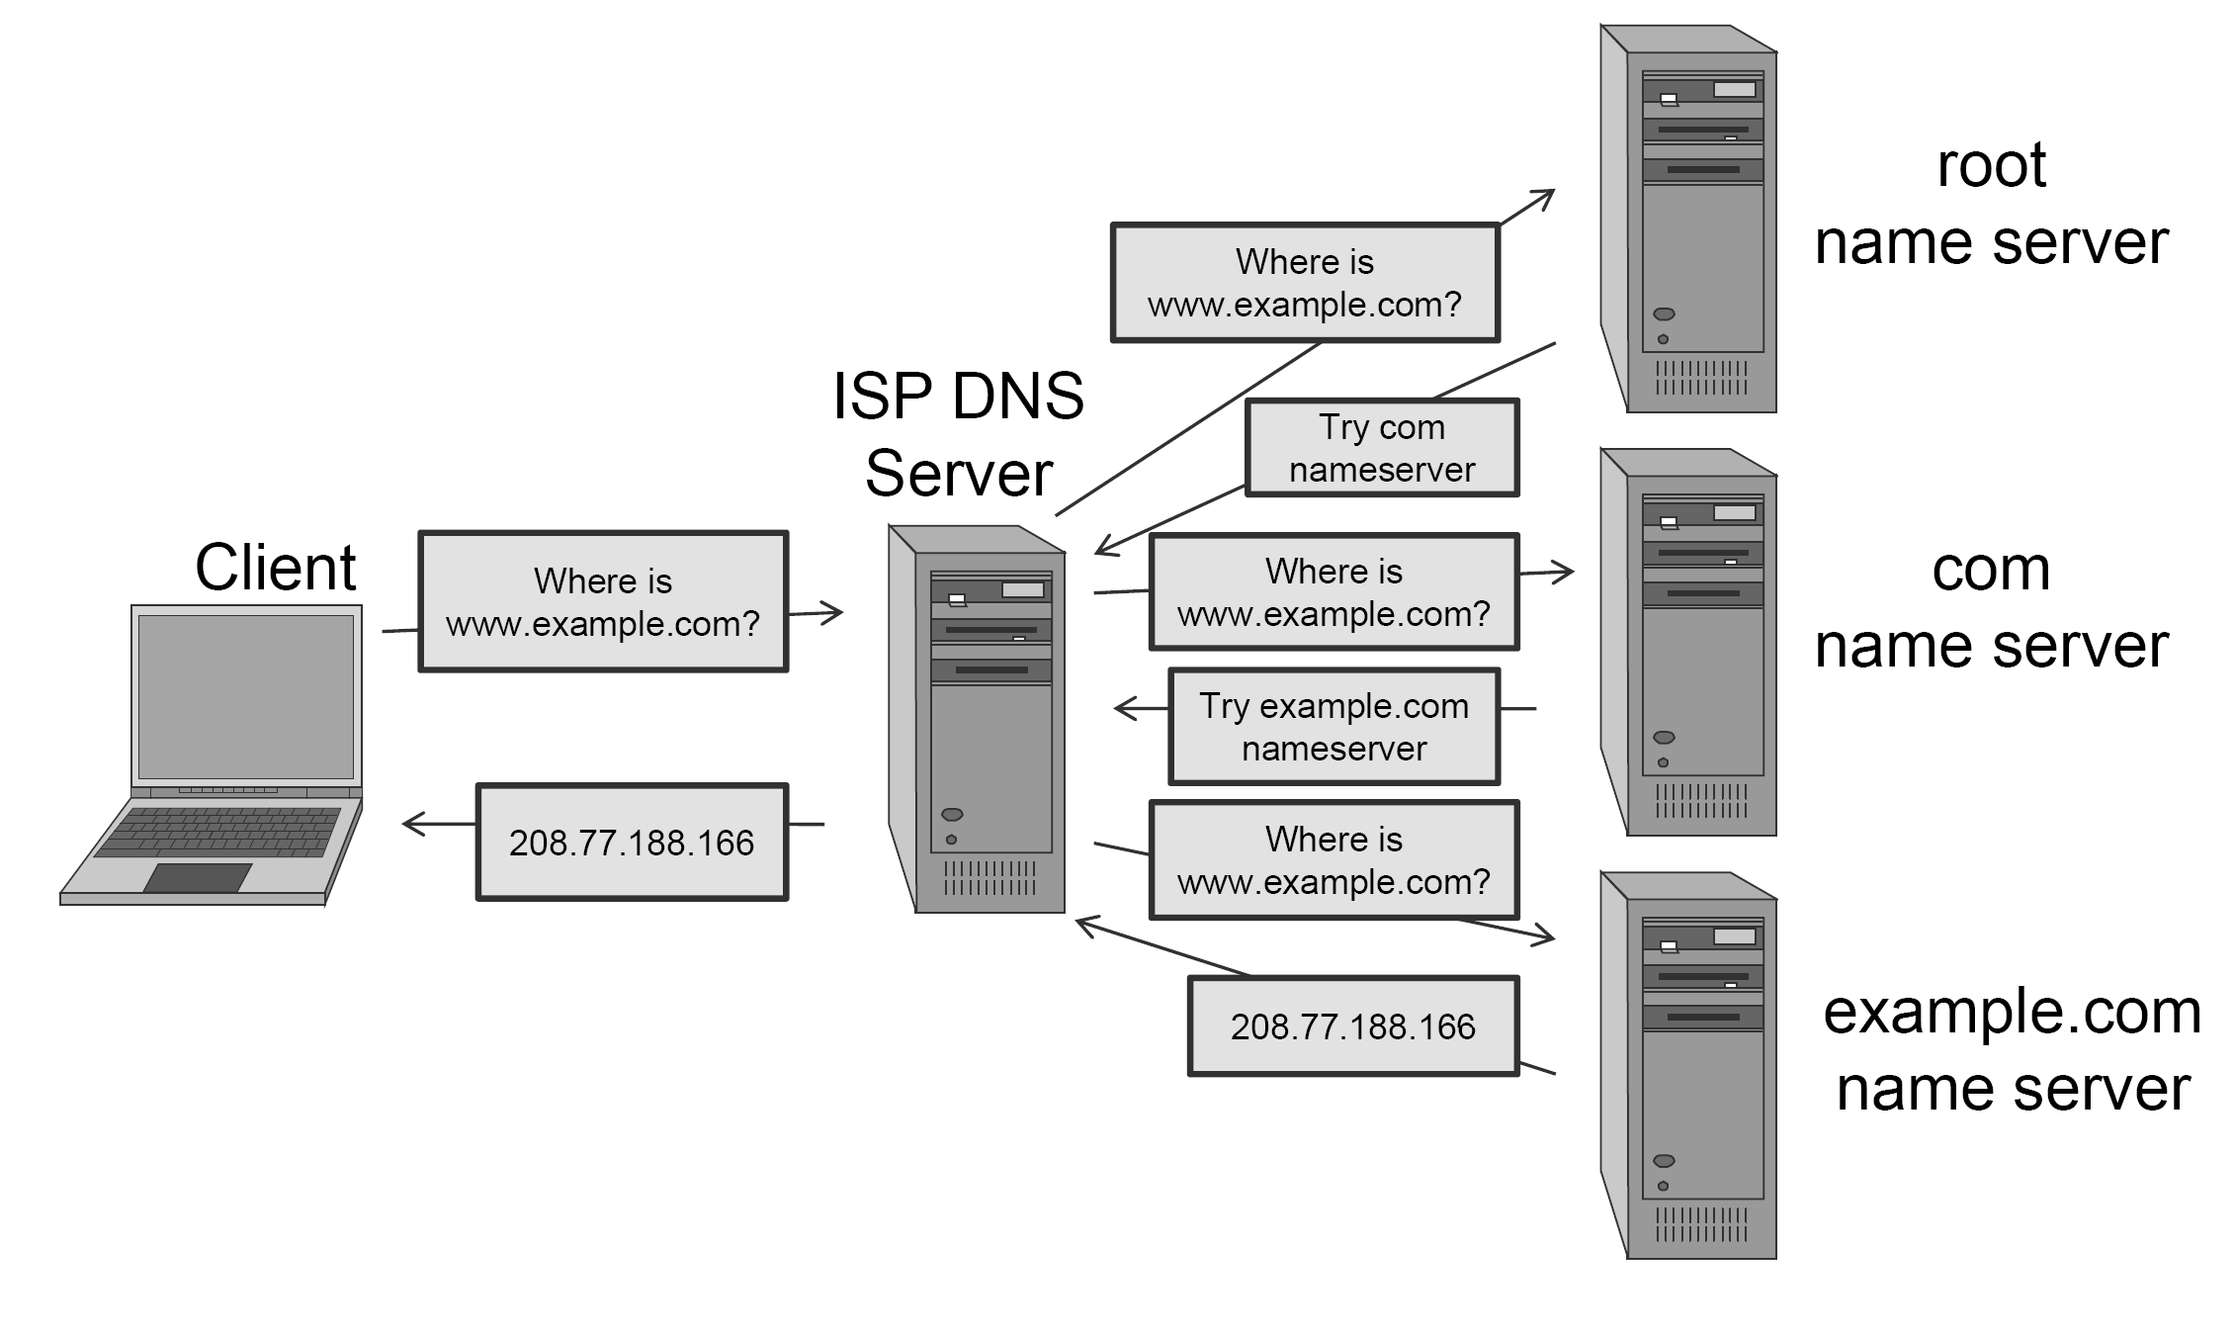
DNS Lookup Process
Example: Looking up for www.example.com
DNS uses UDP port 53 (usually…)

Slide 29
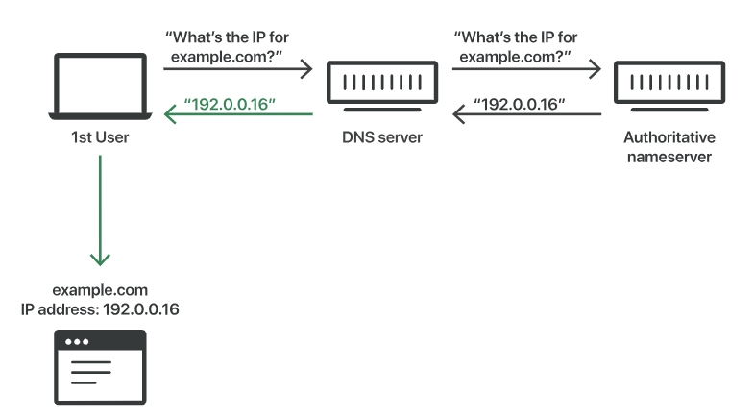
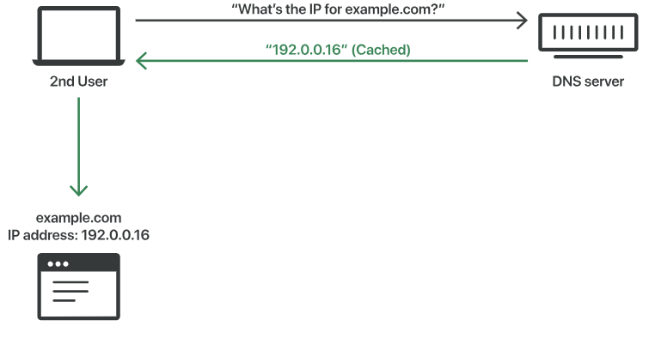
DNS Efficiency - Caching
A DNS resolver will save responses to IP address queries for a certain amount of time.
In this way, the resolver can respond to future queries much more quickly, without needing to communicate with the many servers involved in the typical DNS resolution process.
DNS Uncached Response
DNS Cached Response

Slide 30
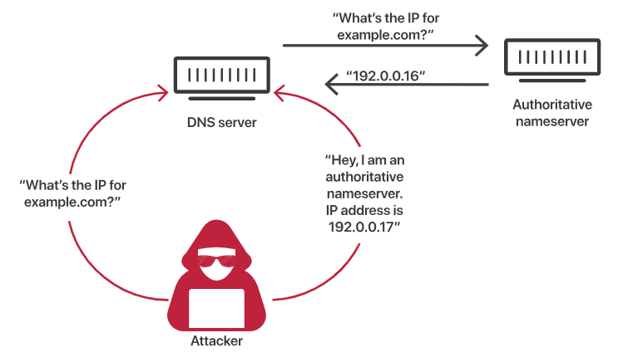
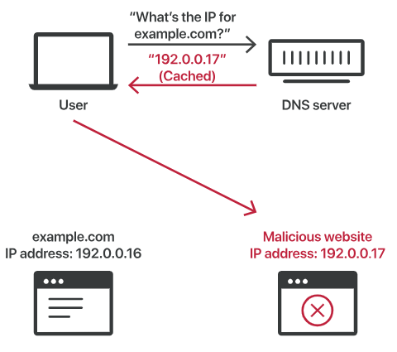
DNS Vulnerabilities Cache Poisoning
UDP make it possible since no verification for DNS information.

Slide 31
DNS Vulnerabilities
Cache Poisoning
Key points:
Attackers have only a few milliseconds to send the fake reply before the real reply from the authoritative nameserver arrives.
Attackers also have to either know or guess:
Which DNS queries are not cached by the targeted DNS resolver
What port* the DNS resolver is using – they used to use the same port for every query, but now they use a different, random port each time
The request ID number
Which authoritative nameserver the query will go to
Random DNS query numbers (reply must match) provide some protection
But: Entropy is low (16 bits), so can flood lots of fake replies
Birthday attack: only need n=213 random replies for prob > ½ of success

Slide 32
Firewalls - Introduction
Network Layer Topology
How are subnets connected together?
Earlier discussion was physical link topology – now logical links
Physical layer considerations:
Point-to-point: Direct connections of two endpoints
Protocols: PPP (point-to-point protocol – typically over serial/phone lines) and PPoE (point-to-point over Ethernet – used by a lot of DSL)
Broadcast: Sent out to “whoever gets it” (e.g., wireless)
Similar issue on ethernet: switches vs. hubs
Interconnection issues:
Ownership: Who owns pieces of the network?
Control: Sub-network administration
Boundary: Separation of separate domains of control

Slide 33
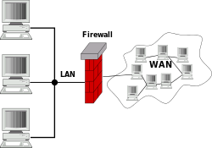
Firewalls - Introduction
Network Layer Topology
Firewalls are the mechanism used to enforce boundaries between subnets.
Monitor traffic between networks
Enforce security policies
Control what is allowed in/out

Slide 34
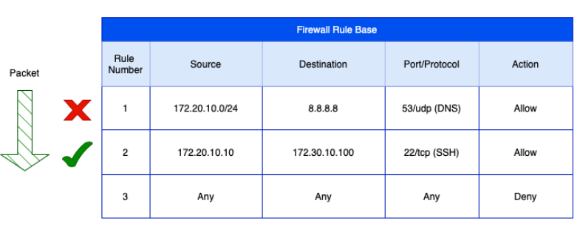
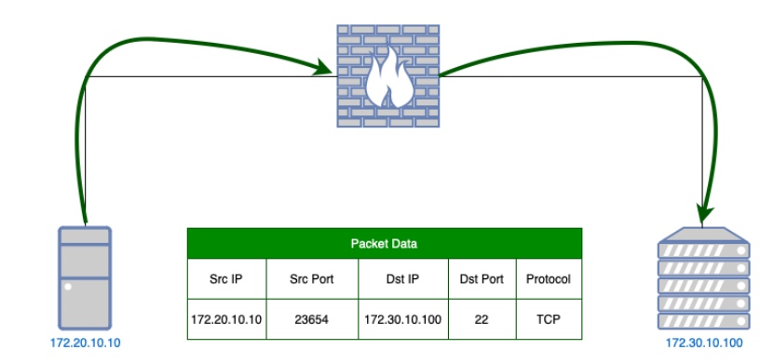
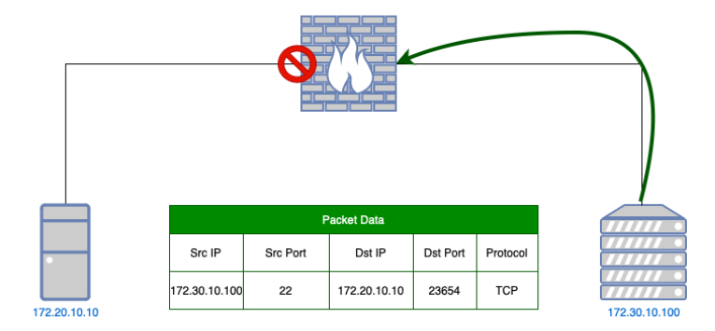
Firewalls
Types of firewalls:
Stateless (“packet filters”)
Decisions made independently on a packet-by-packet basis
Good for blocking ports (“no incoming HTTP”) or blocking IP addresses/ranges (“blacklists”)
Simple and fast – included in many routers

Slide 35
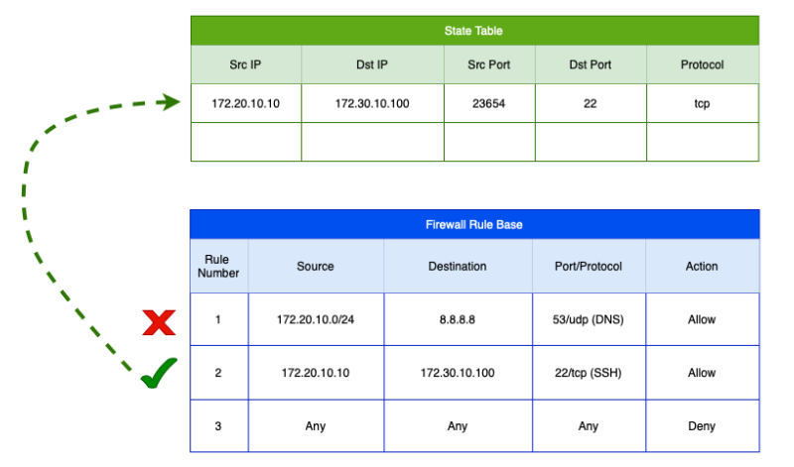
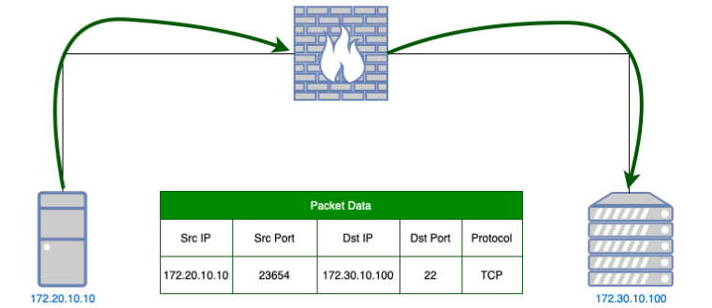
Firewalls
Types of firewalls:
Stateful
Keep information that relates packets to one another
Can track sessions and even related sessions (e.g., FTP control and data)

Slide 36
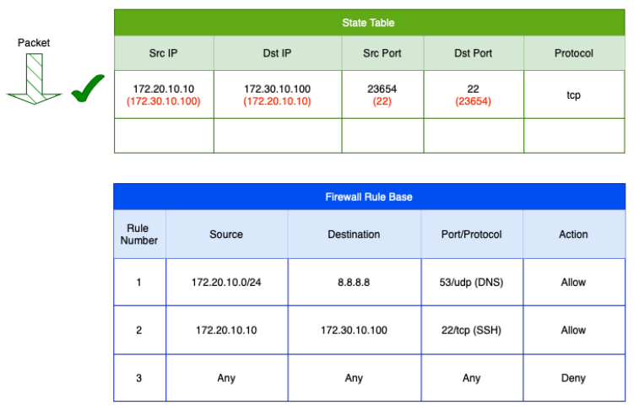
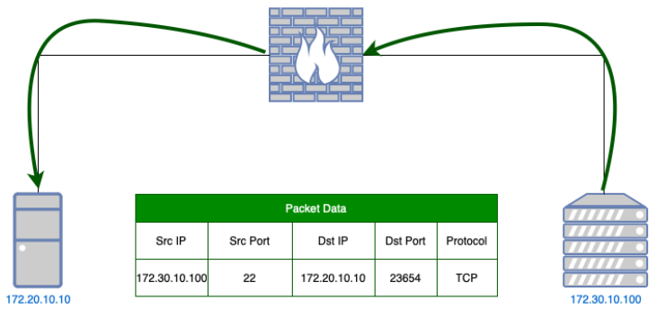
Firewalls
Types of firewalls:
Stateful
Keep information that relates packets to one another
Can track sessions and even related sessions (e.g., FTP control and data)

Slide 37
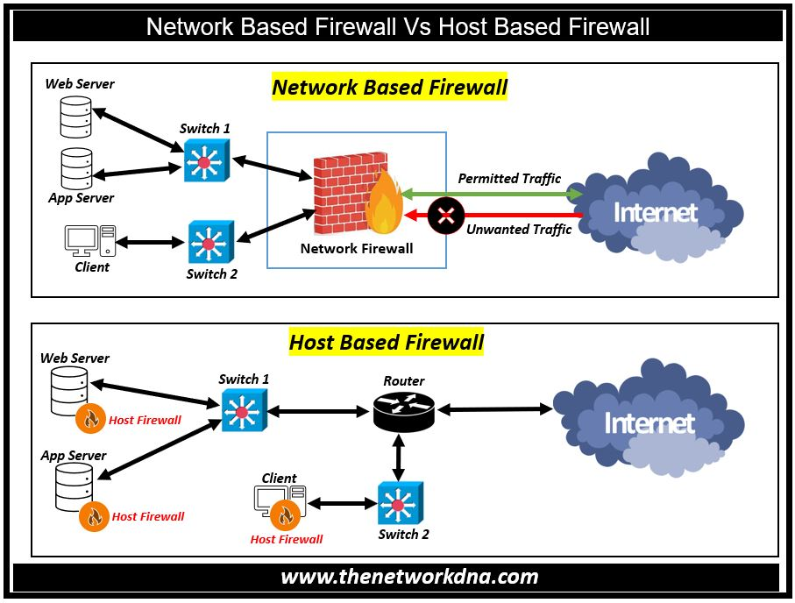
Firewalls Locations
Network-based
Specialized devices at network border
Filter all traffic to enforce organizational policy
Common brands: Cisco PIX, Checkpoint, …
Placed at the boundary of a network to protect everything inside

Slide 38
Firewalls Locations
Host-based (or personal firewalls)
Controls traffic into and out of an individual system
Software running on general-purpose system
Common examples:
Linux: iptables or ufw (really just a front-end to iptables)
Windows: Built-in firewall, Norton personal firewall, ZoneAlarm, BlackIce, and many others
Runs on an individual computer to protect that specific host

